Slide 1


Voluntary Separation Incentive Program 2026
Healthcare Benefit in Retirement
Presented by AFT Local 2373 and
Karen T. Siefring , CNJSCL Delegate
AFT NJ Delegate
Past President, AFT Local 2373
Past Vice President, Council of New Jersey State College Locals (CNJSCL)
&
Assistant Director, Center for Employers and Early Talent Engagement

Slide 2
Voluntary Separation Incentive Program 2026
Healthcare Benefit in Retirement
This discussion centers on what your healthcare benefit may be in retirement (plans and costs), given the number of categories that exist.
We will provide you with some tools to help you figure out where you may fall within our Master agreement with the state of NJ, side letter of agreement IV.
Various links to further help you to explore your options will be shared.
Please note: This is not meant to replace an audit of your service credit or any other related steps needed for you to actually retire with your healthcare benefit; but rather to help you find information to better understand what you need to ask/know in order to make the most informed decisions for yourself and your family.

Slide 3
Fact Sheets to Review
Health Benefits Information – Retirees
https://www.nj.gov/treasury/pensions/hb-info-retired.shtml
PERS https://www.nj.gov/treasury/pensions/documents/factsheets/fact05.pdf
ABP fact38
Health Benefits Coverage – Enrolling as a Retiree
https://nj.gov/treasury/pensions/documents/factsheets/fact11.pdf
State Retired Group Medical Plan Design - Plan Year 2026
https://www.nj.gov/treasury/pensions/documents/hb/oe2026/hr0898.pdf
https://www.nj.gov/treasury/pensions/documents/pdf/creditable-coverage-letter.pdf Your Prescription Drug Benefit and Medicare (Letter 10/25)
Read to discuss with HR

Slide 4
Retirees who are Healthcare Eligible in Retirement
Two Categories of Retirees:
Medicare Eligible and Non- Medicare Eligible
State Retired Group Medicare and Non-Medicare
Monthly Rates Effective
1/1/2026 to 12/31/2026 Medical Including Rx hr1094
https://www.nj.gov/treasury/pensions/documents/hb/oe2026/hr1095.pdf
Dental is a separate cost for all.

Slide 5
Health Benefits in Retirement
Within the previous agreement on CNJSCL website is the side letter of agreement with the Health Benefits you are entitled to based on years of service credit as per State of New Jersey records.
https://cnjscl.org/AFT%20FT%202019-2023%20FT-PT%20-%20Pending%20Reindexing%20-%20Not%20for%20Final%20Publication.pdf (Slides follow with this information in a more understandable form.)
LETTER OF AGREEMENT IV
HEALTH BENEFITS IN RETIREMENT (Carried over since the 2007-20011 contract)
Special Notes: You must make your selections while you are still actively on payroll,
otherwise, you forfeit your earned health benefits in retirement forever.
There are very limited deferral options with strict guidelines; but this is something that you would need to discuss with HR and the NJ Division of Pensions and Benefits.
For ABP: You also must take a minimum one time $1,000 distribution from your retirement benefits plan (not to be confused with the RMD when you turn 73), otherwise you incur financial penalties.
For those eligible (i.e. Professional Staff) this triggers the process for payout of your sick leave benefit.
For PERS: Begin payout, as costs will be deduced for your health care selection (Review this with HR).

Slide 6
Health Benefits at Retirement
Audit of Service Credit
Meet with HR for a review of what’s on file with Rowan. Contact information at the conclusion of the slide show.
Contact:
www.state.nj.us/treasury/pensions
Fax a letter to NJ Division of Pensions and Benefits at 609 777-0479 requesting an “Audit of Service Credit.”
In the letter:
state your name
retirement date (It’s not binding, so pick a reasonable date)
your Social Security number, ABP or PERS number.
This will be used to determine the 25 years of service for the calculation of medical benefits in retirement.
Call: Phone Number: 609-292-7524
Some people may be able to purchase service credit.
Please read Fact Sheet 01 for more information. fact01

Slide 7
Health Benefits at Retirement
General Info
Active medical, prescription drug, and dental coverage continues to end of retirement month.
▪ Retiree health benefits begin the first day of the month following retirement
For January 1 retirement example:
*Active employee health (Medical & Prescription) and dental benefits will end January 31
*Retiree health (Medical & Prescription) and dental benefits will begin February 1
▪ If not electing health insurance coverage, be sure to decline/waive via mynjbenefitshub.nj.gov
(Note rules regarding this as some options, including missed deadlines, forfeit your benefit forever.)
Please include this is your discussions with HR.

Slide 8
mynjbenefitshub.nj.gov
Everyone now needs to have a Benefit Solver account
Navigate to mynjbenefitshub.nj.gov and click Register
• Enter your Social Security Number and Date of Birth
• The Company Key is SHBP/SEHBP
• Once registered, Login using your username and password
NOTE: When you first visit mynjbenefitshub.nj.gov, be sure to
update your contact information to get the latest information about your benefits.
You will also have the option to receive important notifications via text message.
https://www4.benefitsolver.com/benefits/BenefitSolverView?page_name=signon&co_num=31756&co_affid=stateofnewjersey
Q&A
https://www.nj.gov/treasury/pensions/documents/pdf/BenefitsolverRetireeQA.pdf

Slide 9
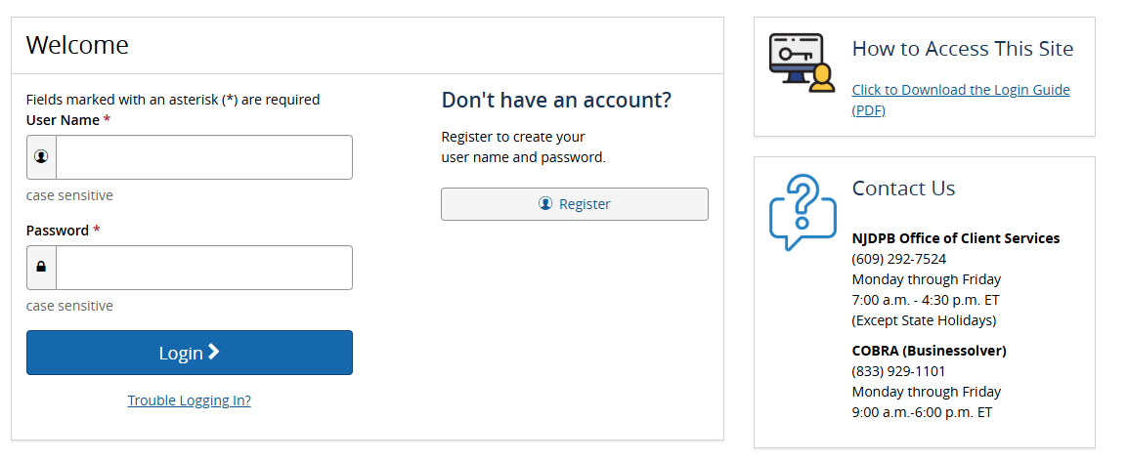
https://www4.benefitsolver.com/benefits/BenefitSolverView?page_name=signon&co_num=31756&co_affid=stateofnewjersey

Slide 10
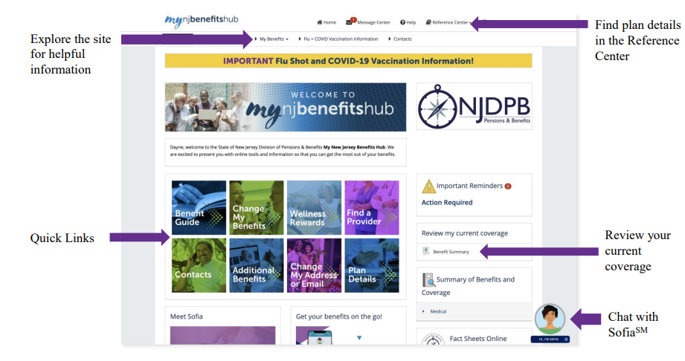
Benefitsolver Dashboard

Slide 11
Qualifying for State-Paid Health Insurance
Prospective retirees who accumulate a total of 25 or more years of nonconcurrent pension credit in ABP or multiple NJ state pension funds (i.e. PERS, PFRS, etc.) may be eligible for State-paid coverage at retirement, as long as they meet the following requirements: -
Must be eligible for employer-paid health benefits immediately prior to retirement/separation.
Must take a minimum distribution ($1,000) within 30 days of retirement date or possible penalized financial penalty.
The State provides partial or full cost of the SHBP coverage for retirees who meet specific service credit or retirement criteria outlined in our: AGREEMENT STATE OF NEW JERSEY (and) COUNCIL OF NEW JERSEY STATE COLLEGE LOCALS AFT, AFL-CIO STATE COLLEGES/UNIVERSITIES UNIT Letter of Agreement IV July 1, 2023-June 30 2027 HEALTH BENEFITS IN RETIREMENT
https://cnjscl.org/AFT%20FT%202019-2023%20FT-PT%20-%20Pending%20Reindexing%20-%20Not%20for%20Final%20Publication.pdf

Slide 12

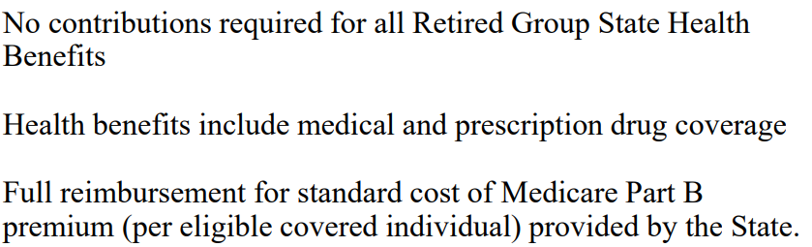

Slide 13
Employees Who Attained 25 or More Years of Service Credit
After July 1, 1997, and Before June 30, 2000
No contributions required for selective Retired Group State Health Benefits or any of the approved HMO Plans, shall not have to contribute to the cost of any premium for health insurance coverage.
If electing Aetna Freedom 10 or NJ Direct 10, contributions required for Retired Group State Health Benefits:
Rates for retirees who share the cost of their coverage: https://nj.gov/treasury/pensions/documents/hb/oe2026/hr0744.pdf
Employees in this group shall receive Medicare Part B reimbursement after retirement up to a cap of $46.10 per month per eligible employee and the employee’s spouse.*
*Employees who began employment or had a break in service after July 1, 1995, or who became eligible for health benefits after that date, may not be eligible for Medicare Part B reimbursement.

Slide 14
No contributions required for selective Retired Group State Health Benefits or any of the approved HMO Plans, shall not have to contribute to the cost of any premium for health insurance coverage.
If electing Aetna Freedom 10 or NJ Direct 10, contributions required for Retired Group State Health Benefits:
Rates for retirees shall pay 25% of the premium cost of their coverage: https://nj.gov/treasury/pensions/documents/hb/oe2026/hr0744.pdf
Employees in this group shall receive Medicare Part B reimbursement after retirement up to a cap of $46.10 per month per eligible employee and the employee’s spouse.*
Employees Who Attained 25 or More Years of Service Credit
After July 1, 2000, and Before June 30, 2007
*Employees who began employment or had a break in service after July 1, 1995, or who became eligible for health benefits after that date, may not be eligible for Medicare Part B reimbursement.

Slide 15
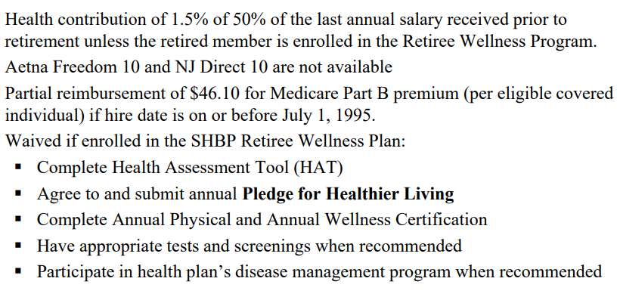
Employees Who Attained 25 Years of Service Credit After June 30, 2007, and before June 28, 2011
Checking to verify if others on the plan on the plan must participate in Wellness Program for waiver.
https://www.nj.gov/treasury/pensions/documents/forms/hr0818.pdf

Slide 16
Employees Who Attained 20 Years of Service Credit by June 28, 2011, and Retire with 25 Years of Service Credit
Health Contribution is 1.5% of 50% of the last annual salary received prior to retirement
▪ Aetna Freedom 10 and NJ Direct 10 are not available
▪ Partial reimbursement of $46.10 for Medicare Part B premium (per eligible covered individual) if hire date is on or before July 1, 1995.

Slide 17
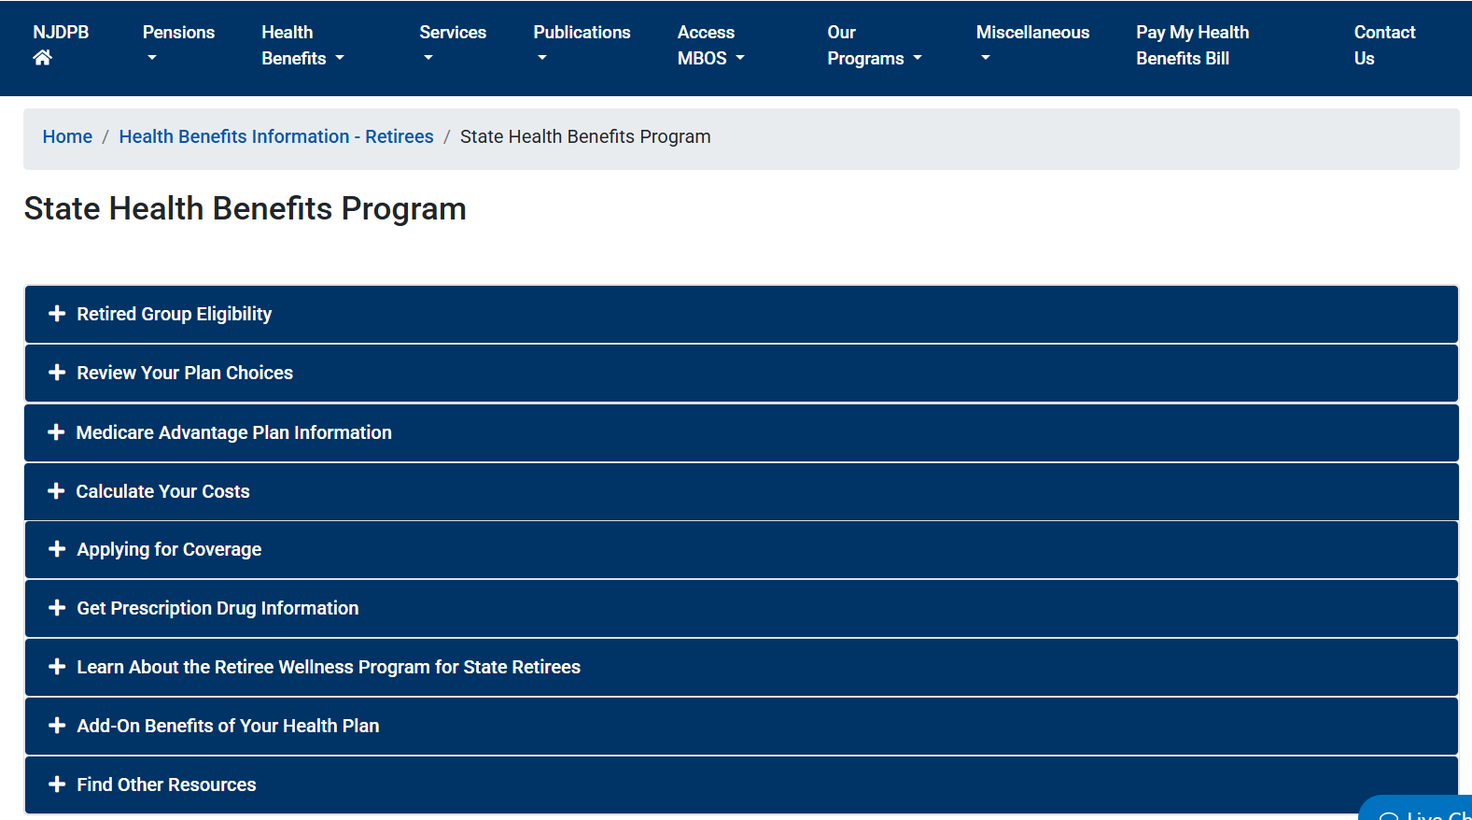
State Health Benefits Program
https://nj.gov/treasury/pensions/hb-retired-shbp.shtml

Slide 18
Employees Who Attained 20 Years of Service Credit After June 28, 2011 and Retire with 25 Years of Service Credit
Health contribution is based on the applicable percentage of premium based on 50% of the last annual salary prior to retirement.
▪ Percentage of Premium for Retirees:
HEALTH BENEFITS CONTRIBUTION — PERCENTAGE OF PREMIUM hr1016
State Retired Group Medicare and Non-Medicare Monthly Rates Effective 1/1/2026 to 12/31/2026 Medical Including Rx hr1094
▪ Aetna Freedom 10 and NJ Direct 10 are not available
▪ Partial reimbursement of $46.10 for Medicare Part B premium (per eligible covered individual) if hire date is on or before July 1, 1995

Slide 19
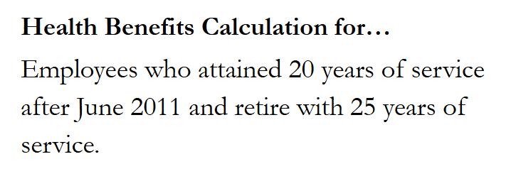

Slide 20
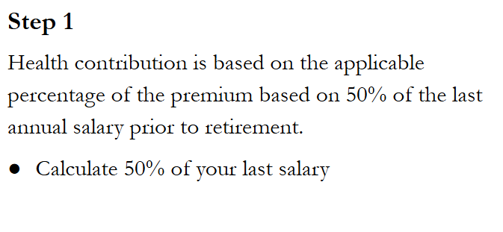

Slide 21
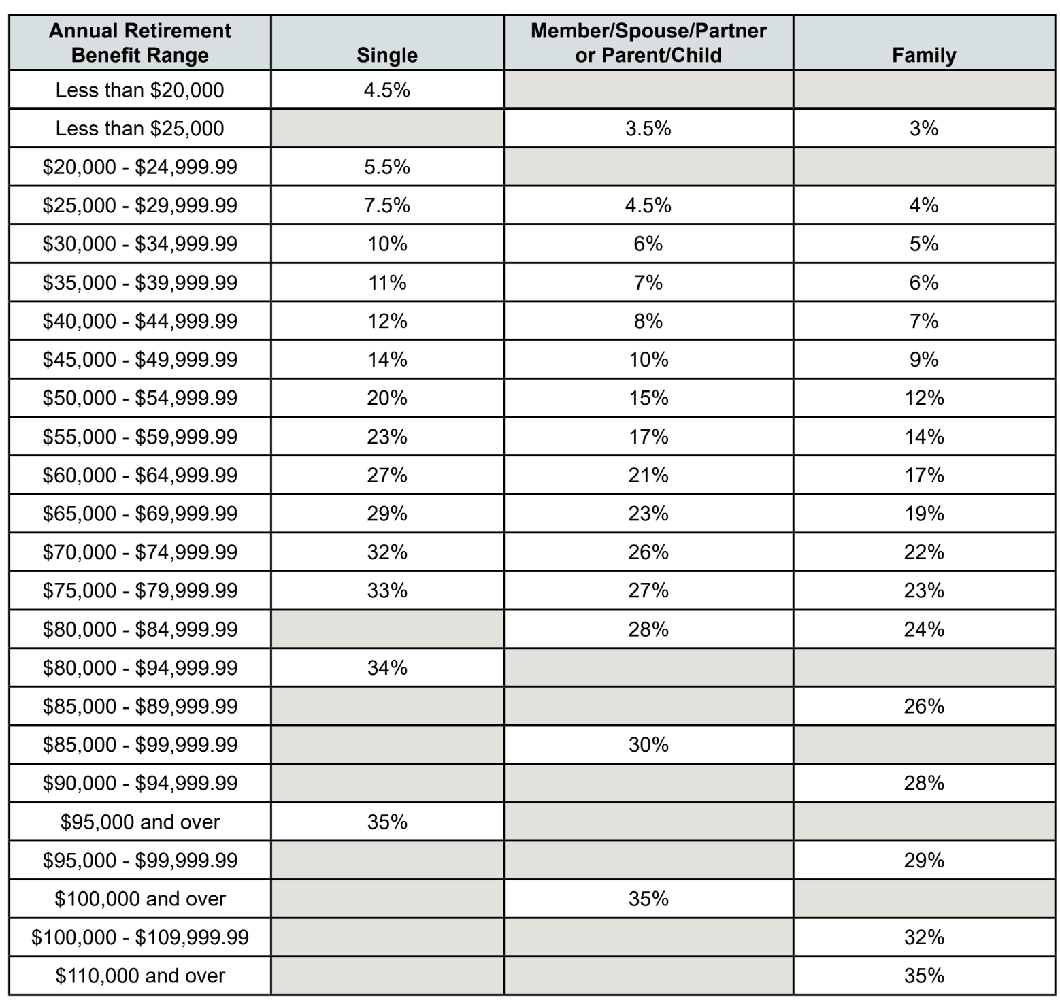
Step 2
Using 50% of your annual last salary - use hr1016 - to determine the percentage of the full cost that the retiree is responsible for.
https://www.nj.gov/treasury/pensions/documents/hb/oe2026/hr1016.pdf

Slide 22

Step 3
Choose a health plan from hr1094 and find the monthly cost.

Slide 23
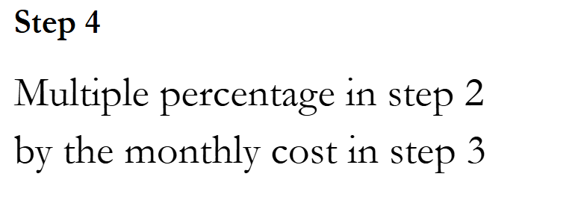

Slide 24
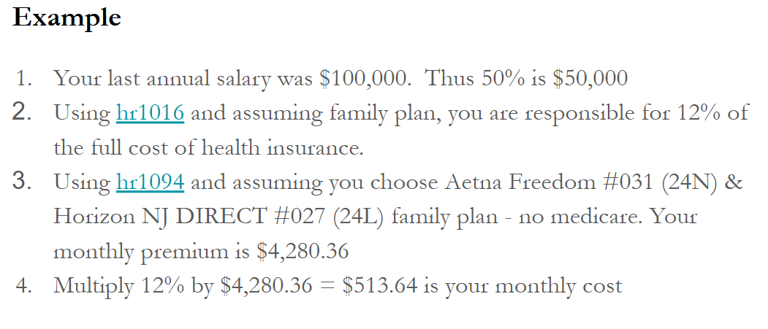

Slide 25
Employees Who Retire With Less Than 25 Years of Service Credit
Required to pay the full group rate on the State’s web site.

Slide 26
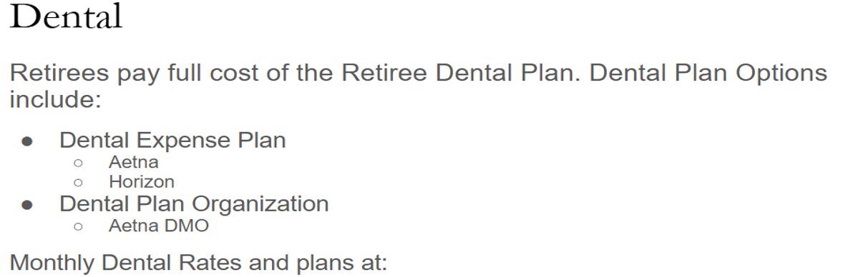
https://www.nj.gov/treasury/pensions/documents/hb/oe2026/hd1169.pdf
https://www.nj.gov/treasury/pensions/documents/factsheets/fact73.pdf

Slide 27
Prescription Drug Plan
Retirees enrolled in a SHBP or SEHBP medical plan have access to the Retiree Prescription Drug Plan.
Member Guidebook is Hp0506
Your Prescription Drug Benefit and Medicare (Letter 10/25)
https://www.nj.gov/treasury/pensions/documents/pdf/creditable-coverage-letter.pdf
Read to discuss with HR

Slide 28
Enrolling in Retired Group State Health Benefits Medicare Part A and Part B Enrollment
Two months prior to retirement, retirees and/or their spouses/same-sex domestic or civil union partners, that are age 65 and older are required to enroll into Medicare Part A and Part B.
Medicare & You 2026
https://www.medicare.gov/publications/10050-medicare-and-you.pdf
▪ You can enroll in Medicare in the following ways: Online at www.SocialSecurity.gov Calling Social Security at 1-800-772-1213 (M-F 7AM to 7 PM) In- Person at your local Social Security Office
▪ Social Security Administration works with Medicare Services by enrolling
You must to work with HR for necessary Employment Verification for Part B.

Slide 29
Considering Retiring Though This VSIP
Please contact Human Resources:
Jillian Itri, itri@rowan.edu
Coordinator of Pension/Retirement & Supplemental Annuities For guideline information to support your decision
Scott Agostini, agostini@rowan.edu Senior Director Operations For information/questions about the VSIP

Slide 30
Life Insurance in Retirement
Must have 10 years of service credit
Must be at least age 60
Amount = ½ (one-half) of the annual base salary
Must take the minimum distribution within 30 days of retirement date
https://www.nj.gov/treasury/pensions/documents/factsheets/fact13.pdf

Slide 31
Employment After Retirement Restrictions
There are restriction on working or volunteering after retirement by law and regulation in NJ. Failure to follow this can lead to your benefits being suspended or cancelled entirely, which may also involve repayment of benefits received.
You must have a:
“Bona fide severance of employment [which] means there [is] a complete termination of the employer/employee relationship for a period of at least 180 days from the date of retirement….”
https://www.nj.gov/treasury/pensions/documents/factsheets/fact86.pdf
See the footnotes on the bottom of page 2 of this fact sheet. This does not have ABP in it specifically; but taken with the ABP fact sheet 38 and the All Funds note at the top, would apply to all.
“1. Employees that work a 10-month school year and retire on July 1 or August 1 must count the 180-day severance of employment from the start of the following normal school year in September.
“2 . The IRS does not consider a pre-arranged return to public employment to be a bona fide severance of employment, no matter how long the break in service. If you and your employer made an arrangement prior to your retirement to return to employment in any capacity, at any future time, including as a volunteer — regardless of whether the position is covered by the former retirement system — your employment relationship will not be completely severed and your retirement will be considered non-bona fide, or invalid.”
Alternate Benefit Program (ABP)
Under Post-Retirement Employment Restrictions page 2
https://www.nj.gov/treasury/pensions/documents/factsheets/fact38.pdf
This discusses the 180 days and refers to “the requirements of a bona fide severance of employment as defined under N.J.A.C. 17:1-17.14(a)2.”
Fact sheets 38 and 86 are based on this and 10-month employees would be held to the September 1 date.
Should you decide to return to work after this 180-day period, there is an application that must be completed first.

Slide 32
Thank you!
Thank you to the following people and sources for providing information and guidance for this presentation.
AFT Local 2373 and our office staff
Dr. Richard Wolfson, Organizer, AFTNJ Retirees Chapter Local 8028R Retired Professor , Montclair State University
Past President, AFT Local 1904
Debra Davis, AFT Local 2373 Consultant
Retired Senior Staff Representative, Council of New Jersey State College Locals (CNJSCL)
Dr. Eric Milou, Professor, Department of Mathematics
Past President of the Rowan University Senate
Rowan University Human Resources
Rutgers University Human Resources

